Slide 1





Project Name
Student Attendance & Performance Analysis
Team Members
Guided by
1. Name: Deepa
2. Name: Shiwani
3. Name: Kavita Singh
1. Shailesh Yadav

Slide 2

Problem Statement
Manual attendance management is time-consuming and may lead to errors.
Maintaining large numbers of student records is difficult.
It is challenging to identify students with low attendance quickly.
Manual performance analysis requires more time and effort.
Attendance and academic performance data are difficult to compare without proper analysis.

Slide 3
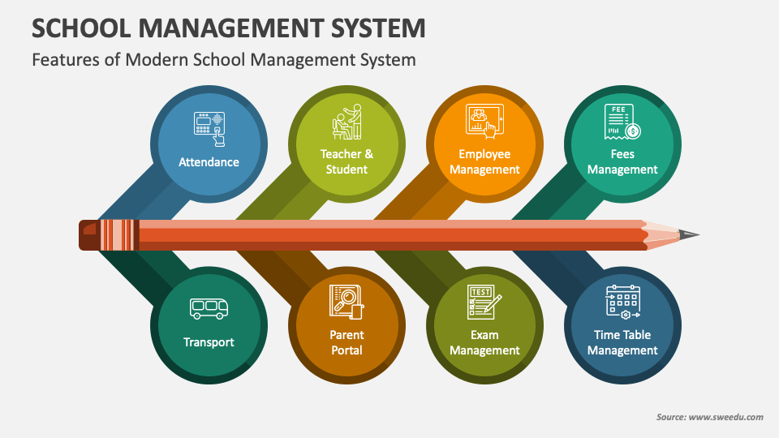
Solution
Develop an Excel-based Student Attendance and Performance Analysis system.
Maintain student attendance and academic performance records in one worksheet.
Calculate Attendance %, Percentage, grade, and result using formulas.
Use Conditional Formatting to identify attendance and performance status.
Use Pivot Tables and Pivot Charts for easy data analysis.
Use charts and dashboard elements to present results clearly.

Slide 4
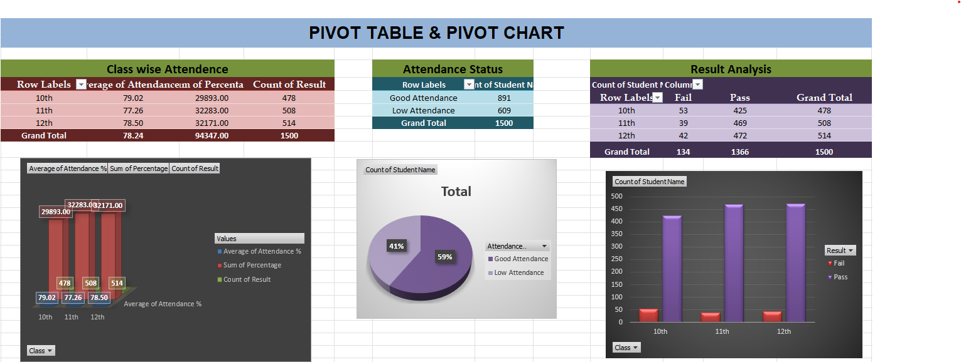
Project Demo
Git hub Link

Slide 5

Future Scope
Automatic attendance recording using biometric systems.
Integration with QR code-based attendance.
Automatic SMS/email alerts for low attendance.
Student performance prediction using AI.
Real-time attendance and performance dashboard.
Integration with school/college management systems.
Career Growth

Slide 6

Conclusion
Successfully developed a Student Attendance and Performance Analysis system.
The system helps maintain student attendance and academic records efficiently.
Attendance percentage, grades and results can be calculated automatically.
Pivot Tables and Charts make data analysis easier.
The project reduces manual effort and helps identify student performance patterns.

Slide 7


Notes:
Thank You !!

